Slide 1
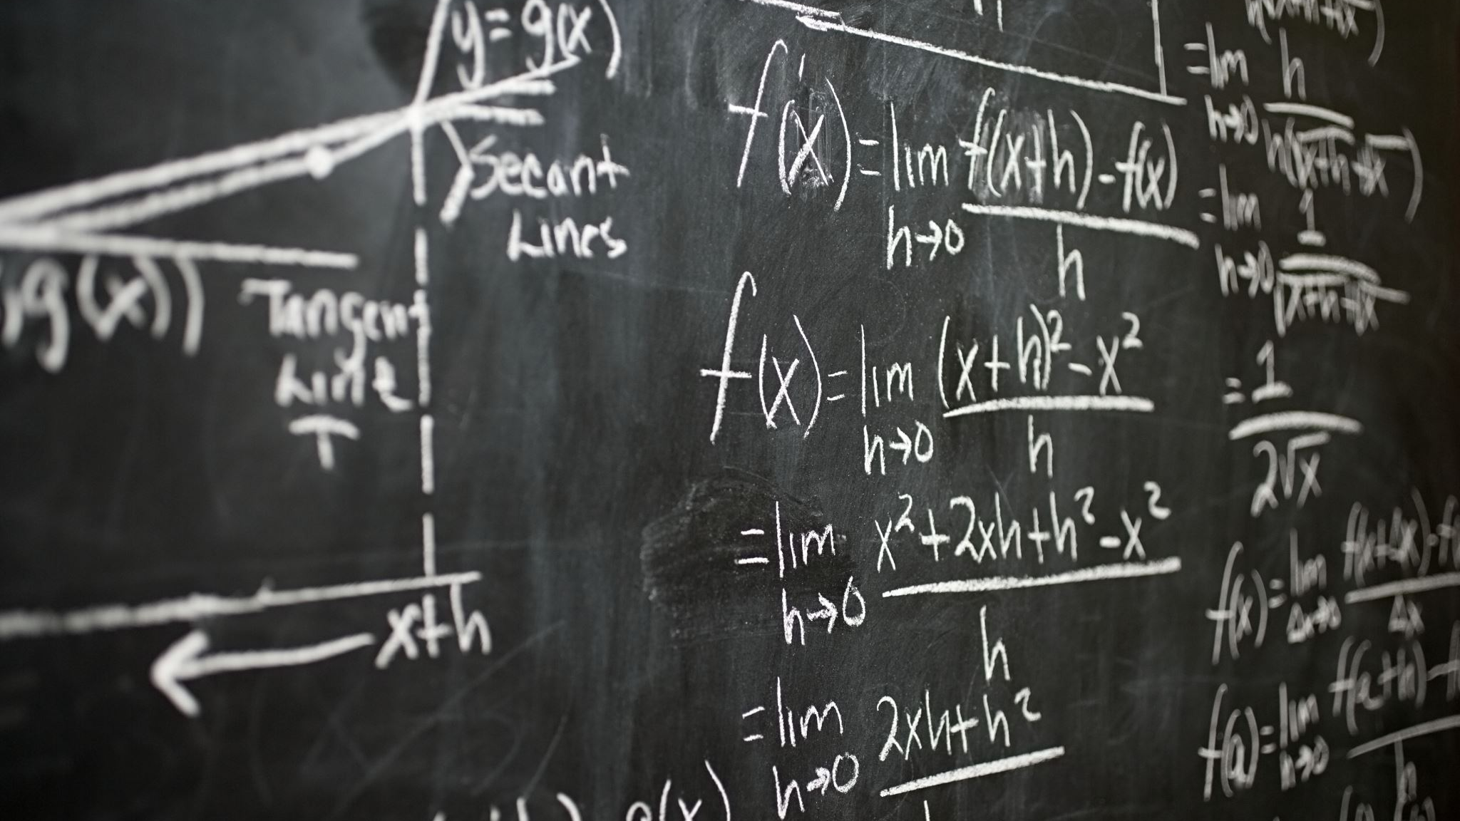
Neural Networks Can(not) Do Math
Bhumika Mistry
Notes:
45mins (incld. questions)
35-40 present

Slide 2
Bit about me…
Final Year PhD Student
Part of the VLC (Vision, Learning and Control) research group
Thesis writeup
Area of research
Systematic generalisation
Extrapolative arithmetic with neural networks

Slide 3
Contents
Recap of MultiLayered Perceptrons (MLPs)
Universal Approximation Theorem
1 (hidden) layer MLPs as universal approximators
Learning to add 2 numbers with MLPs
Learning to multiply 2 numbers with MLPs
Neural Arithmetic Logic Modules

Slide 4
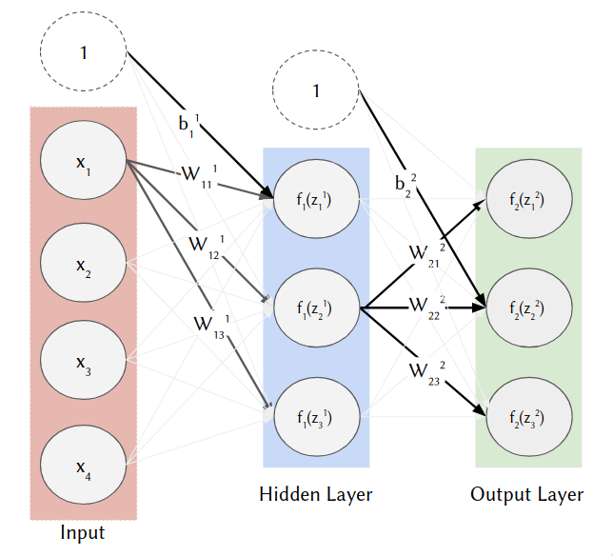
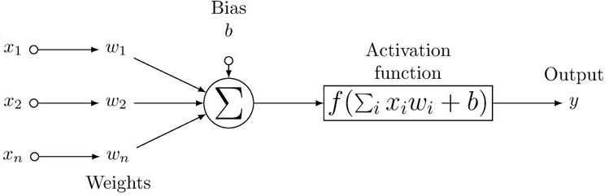
MLPs (recap)
MLP (depth 2, width 3) with 4 inputs, 3 outputs
Breakdown for a single hidden neuron
Partial copy of Figure 1 Pérez-Enciso, M., and L. M. Zingaretti. "A guide for using deep learning for complex trait genomic prediction. Genes (Basel) 10: 553." (2019).
Sourced from https://harvard-iacs.github.io/2020-CS109A/lectures/lecture28/notebook-2/
Notes:
Each hidden neuron is a linear combination of the prev layer’s inps/neurons with a (non-lin) activation func applied
FC neurons
Hidden-output = linear activation

Slide 5
Universal Approximators
Given a feedforward network with 1 hidden layer (i.e., depth 2) using nonpolynomial activations and enough neurons (i.e., sufficient width), it is possible to learn an approximation to any Borel measurable function (e.g., continuous function) to an arbitrary degree of precision (i.e., any nonzero amount of error).
Caveats:
It’s an approximation
Learns up to a error threshold above 0 → ‘arbitrary degree of precision’
The best architecture for approximating a function is unknown
Notes:
The actual definition is a bit more general (i.e. atleast 1 hidden layer) but for today’s lecture this is fine
Best arch – at best you can derive upper and lower bounds (which continues to be a growing area of research)

Slide 6

Learning Addition of Two Numbers
Learn to model $f\left(x_{1},x_{2}\right)=x_{1}+x_{2}$
Are real numbers e.g., 2.4, 6.343, …
Experiment setup:
Training (interpolation) range: U[1,2) | Activation function (nonpolynomial activation): ReLU
Test (extrapolation) range: U[2,6) | Batch size: 128
Hidden layers: 1 | Seeds: 25
Width: 1 or 100 | Optimizer: Adam
Epochs: 50,000 for if MLP(1), 2 million if MLP(100) | Success threshold’s epsilon: 1e-5
Notes:
Extrap range will not overlap with interp
Seeds = diff inits and diff training data

Slide 7
Which network will learn addition?
Width of 1?
Width of 100?
Neither?

Slide 8
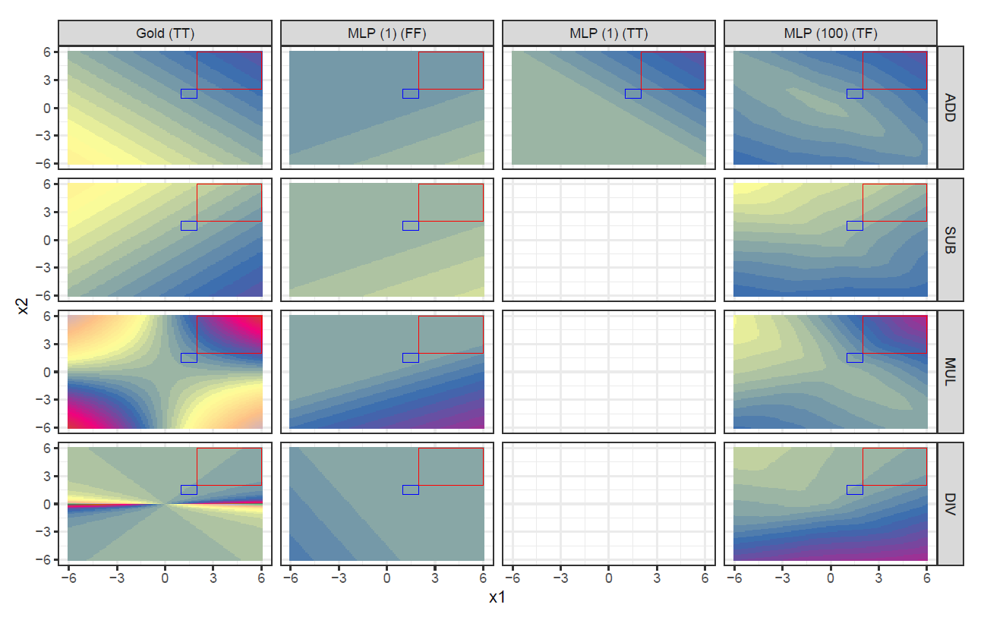

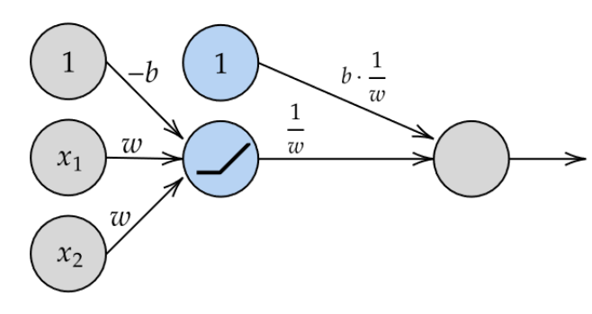
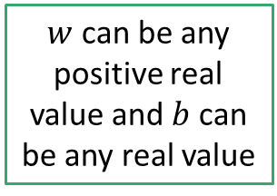
Results
The letters in the brackets are True (T)/False (F), representing if the minimum loss threshold for the interpolation and extrapolation range has been met respectively. The blue and red squares represent the interpolation (training) and extrapolation (test) ranges respectively.
Width-100 models have no success on the extrapolation range
Width-1 models do have success on the tested extrapolation range but fails if the extrapolation range is extended to [-6,6].
$w$ can be any positive real value and $b$ can be any real value
The (generalized) learnt expression is:
This expression can do addition on any real number, but only for positive inputs!
Notes:
1 = 5 params = 20% interp; 20% extrap
100 = 401 params = 100% interp; 0% extrap
4 (no bias) = 12 params = 92% interp; 36% extrap
NAU = 2 params = 100% interp; 100% extrap

Slide 9
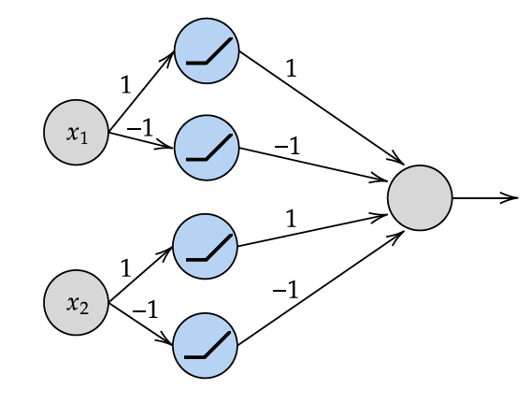
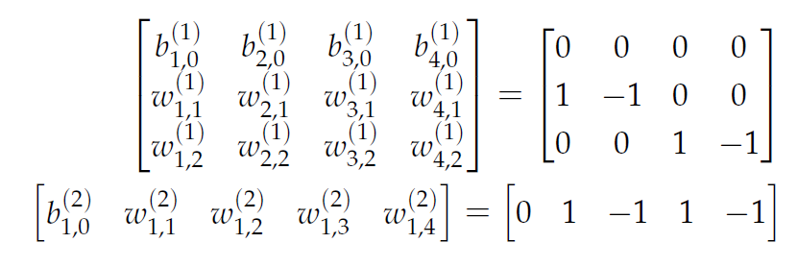
Can we build a 1HL MLP to do addition on any real number?
Yes; using a width of 4
The 1st and 3rd hidden units preserve the magnitude of the 2 inputs for positive values
The 2nd and 4th hidden units preserve the magnitude of the 2 inputs for negative values
The hidden-to-output layer reapplies signs of negative inputs and does the addition
Only displaying the non-0 parameters

Slide 10
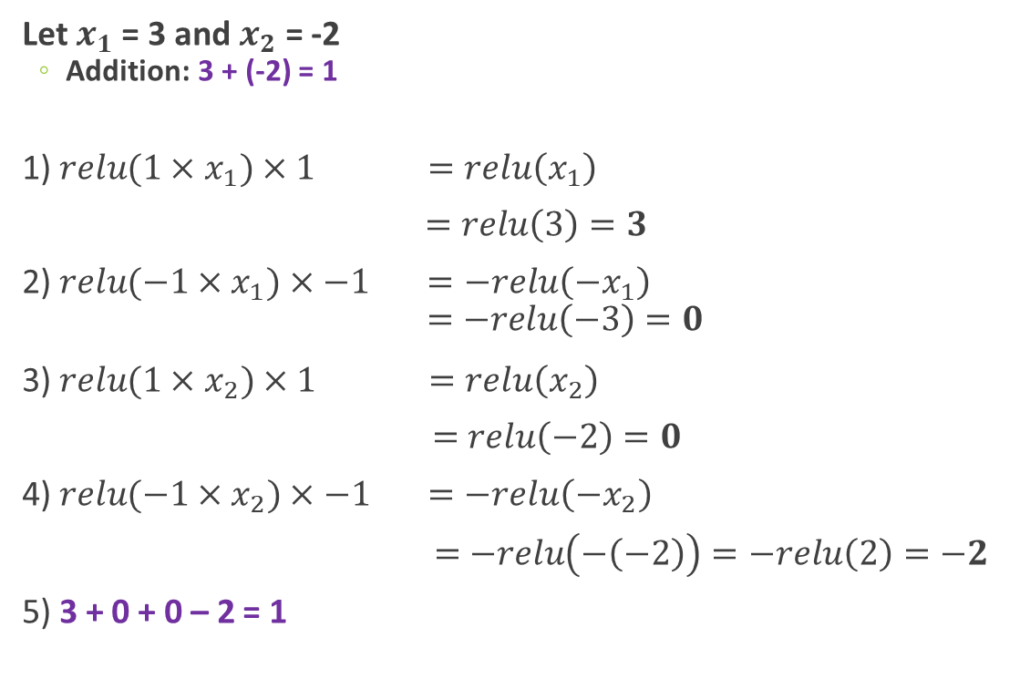
Step-by-step example
Let $x_{1}$= 3 and $x_{2}$ = -2
Addition: 3 + (-2) = 1
1) ${relu(1×x}_{1})×1 =relu\left(x_{1}\right)$
$=relu\left(3\right)=3$
2) ${relu(−1×x}_{1})×−1 =−relu\left({−x}_{1}\right)$
$=−relu\left(−3\right)=0$
3) ${relu(1×x}_{2})×1 =relu\left(x_{2}\right)$
$=relu\left(−2\right)=0$
4) ${relu(−1×x}_{2})×−1 =−relu\left({−x}_{2}\right)$
$=−relu\left(−\left(−2\right)\right)=−relu\left(2\right)=−2$
5) 3 + 0 + 0 – 2 = 1

Slide 11
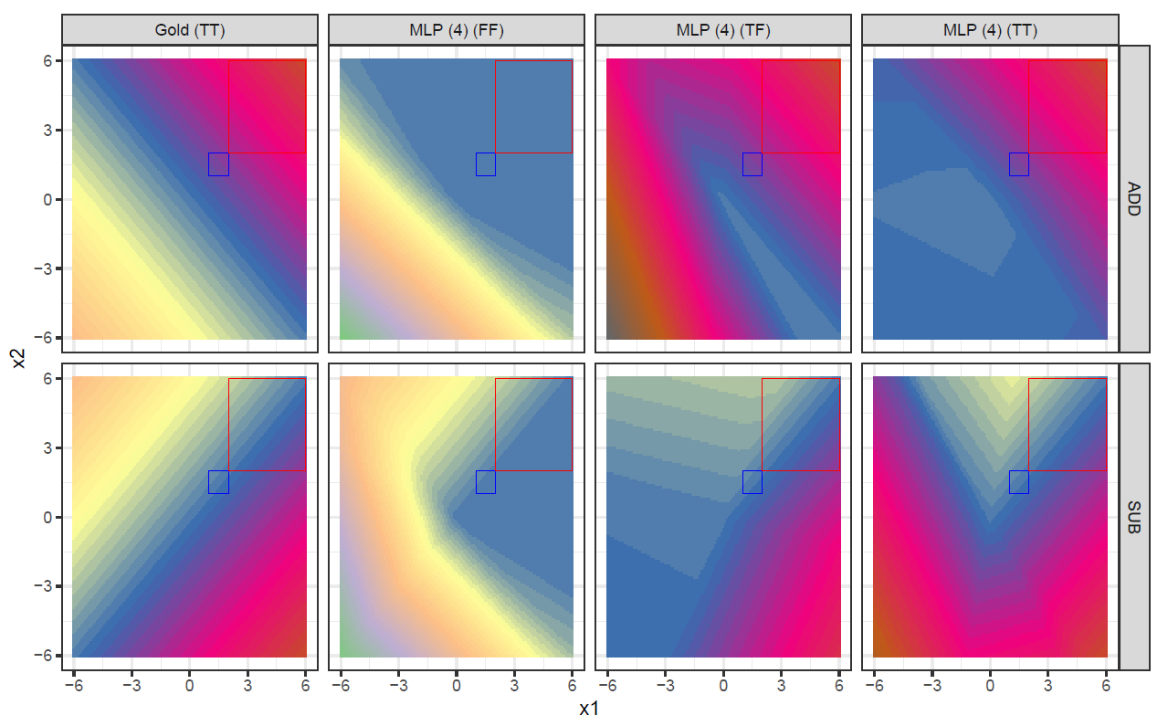
Does it work empirically?
No.
Similar issues to MLPs for width 1 and 100
Learns addition in the interpolation range
Fails to learn true addition
Looking into the weights, we find that the network tries to utilise ALL the available weights resulting in:
A complex expression lacking interpretability (for a human)
An expression which cannot generalize

Slide 12

Multiplying Two Numbers
Learn to model $f\left(x_{1},x_{2}\right)=x_{1}×x_{2}$
Q) How many neurons do we need for it to learn 2-input multiplication on real values?
A) Infinite
Why? So the MLP can memorise every possible combination
This also implies that an infinite number of training samples is required

Slide 13
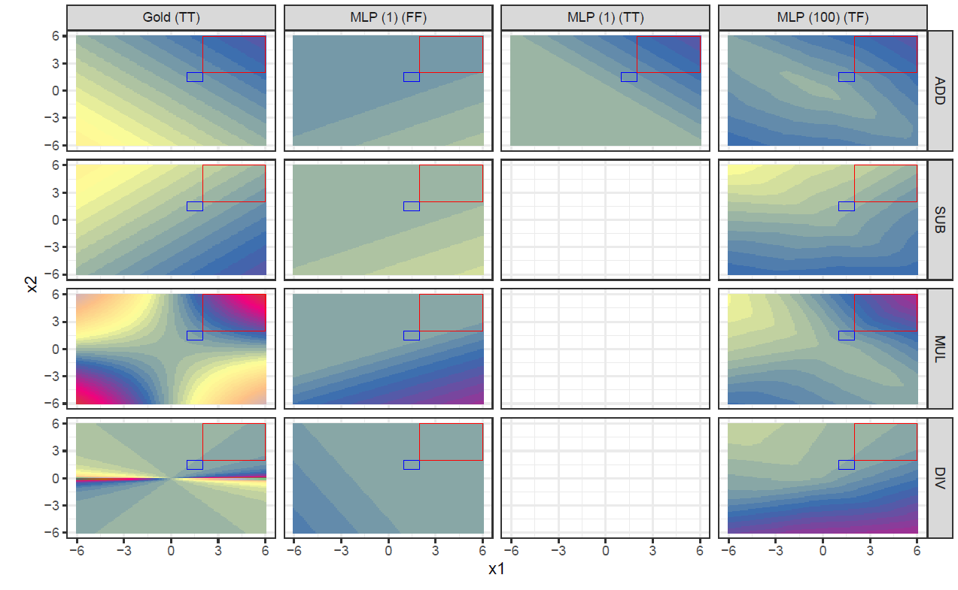
The four arithmetic operations

Slide 14
How to learn maths with neural networks?
MLPs cannot do basic arithmetic
What do we want?
Extrapolation: Something which can learn to generalise to unseen combinations
Has systematic generalisation instead of memorisation
Sample efficiency: Something which does not require too many data samples during training to learn
Interpretability: Something which we can confirm has learn the expression as expected (opposite of a black-box model)
What other options are there?
Using another type of building block
Transformer (Language Models) - SOTA architectures for many sequence-to-sequence translation tasks
Trained on billions of parameters
Still can fail on simple arithmetic and reasoning
Ones with inductive biases (i.e., innate priors) towards learning arithmetic
Notes:
Transformers – (quick mention) rethink task as a sequence, language based task

Slide 15
Neural Arithmetic Logic Modules (NALMs)
Neural networks
Learn using supervised learning and gradient descent
Specialised to learn arithmetic/logic operations
Particular weights refer to specific operations
No need for infinite number of weights
Extrapolation possible after seeing a subset of possible data samples

Slide 16
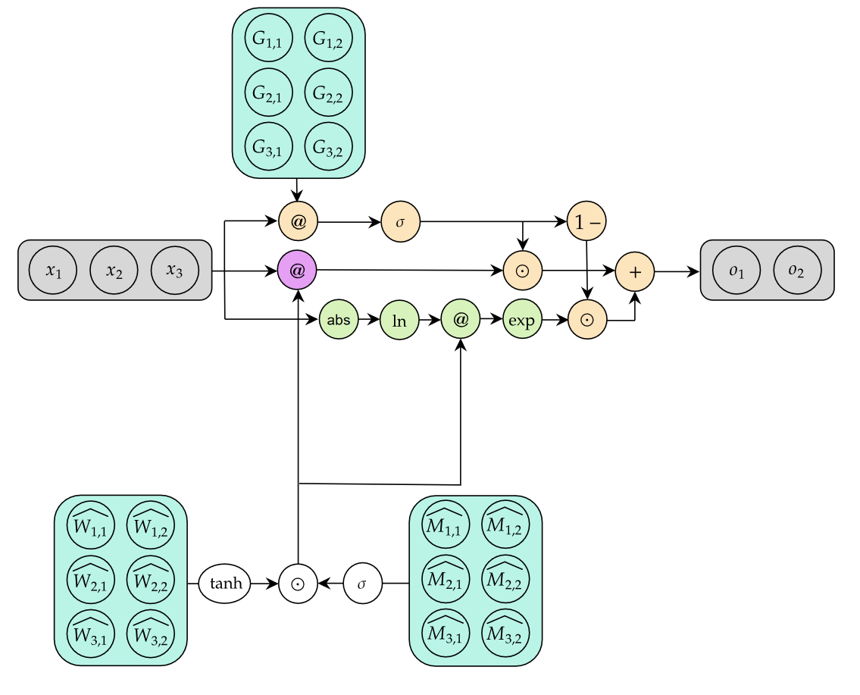
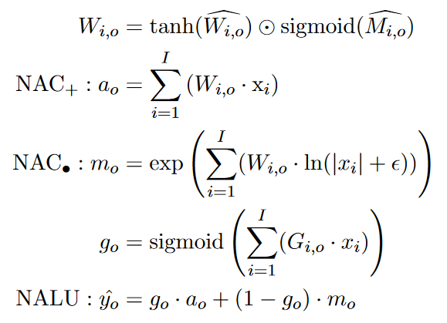
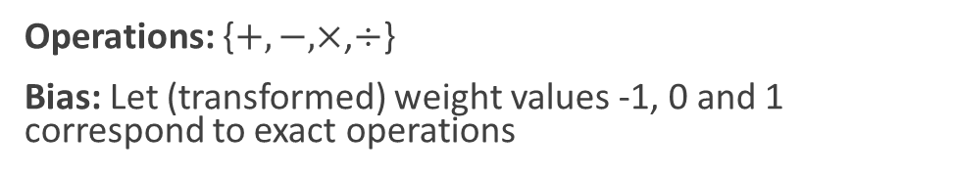
Neural Arithmetic Logic Unit (NALU) (Trask, et. al)
(Transformed) Weight Value | Operation
-1 | Subtraction/Division
0 | No selection
1 | Addition/Multiplication
Operations: {$+, −,×$,$÷$}
Bias: Let (transformed) weight values -1, 0 and 1 correspond to exact operations
Value between [-1,1]
Summative: Add/sub
Multiplicative:
Mul/div
Summative/ Multiplicative selection
Trask, A., Hill, F., Reed, S.E., Rae, J., Dyer, C. and Blunsom, P., 2018. Neural arithmetic logic units. Advances in neural information processing systems, 31.
Notes:
These weights obtained via combining non-lin transf (such as tanh and sigmoid) on w.matricies
3 parts
Weights passed to a summative module which applies …
MLP 1 = 5 params = 20% interp; 20% extrap
MLP 100 = 401 params = 100% interp; 0% extrap
MLP 4 (no bias) = 12 params = 92% interp; 36% extrap
NALM NAU = 2 params = 100% interp; 100% extrap
NALU = 6 params ; 80% extrap

Slide 17
Summary
Universal Approximation theorem for MLPs
In theory, we can approximate any continuous function
In practice, the learnability of the function is not guaranteed
Shown how MLPs fail to learn simple arithmetic
Addition – Even though we can create a MLP of width 4 which can learn addition exactly!
Multiplication
Alternative to MLPs
Extrapolation, sample efficiency and interpretability
Neural Arithmetic Logic Modules (NALMs)
Explained at the architecture of the first NALM, the NALU

Slide 18
Extra Material (if you are interested)
Universal Approximation Theorem
Reading: Deep learning book (Section 6.4.1 ‘Universal Approximation Properties and Depth’) → https://www.deeplearningbook.org/contents/mlp.html
Nice high-level overview of UAT
Lecture: https://www.youtube.com/watch?v=lkha188L4Gs
~1hr 10min lecture providing strong foundational understanding about UAT and talks about the power of depth
Reading: http://neuralnetworksanddeeplearning.com/chap4.html
Has (interactive) visual guides to show you how MLPs can be composed into complex networks
But note that you’ll be covering this anyway later with Jon!
Neural Arithmetic Logic Modules
NALU paper: https://arxiv.org/pdf/1808.00508.pdf
NALM (a comprehensive primer): https://arxiv.org/pdf/2101.09530.pdf
More detail about NALMs, existing architectures, benchmarks and examples of applications.

Slide 19
Questions

